Slide 1
Imdb movie analysis
A Project on Statistics

Slide 2
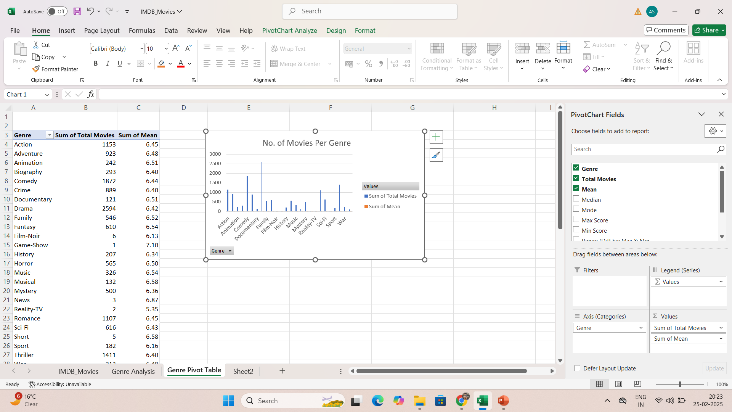
Movie Genre Analysis
Few genres are more common and are being made more frequently such as Action, Comedy, Drama, Romance & Thriller.
Average rating of all the genres is almost same other than Game-Show and Reality-TV as it does not have much number of movies made in these genres.
Mode for Game-Show, Reality-TV, News, Short & Film-Noir can not be calculated as there are no same ratings.
Romance and Comedy have got Max rating i.e. 9.5 and Comedy has got Min rating as well i.e. 1.6.
Variance and Standard Deviation are very low which indicates ratings are stable and do not vary much.

Slide 3
Movie Duration Analysis
Filled missing movie duration value with median value i.e. 103.
Avg movie duration – 107.19
Median movie duration – 103
Mode of movie duration – 90
Standard deviation of duration – 25.16 which indicates most movies vary by 25 minutes from average 107 minutes.
Scatter plot suggests that most movies have time duration of 100-150 minutes and IMDB scores 6-8.
Trendline is slightly upwards which indicates that movies with higher time duration tends to have high IMDB scores, but effect is not very strong.

Slide 4
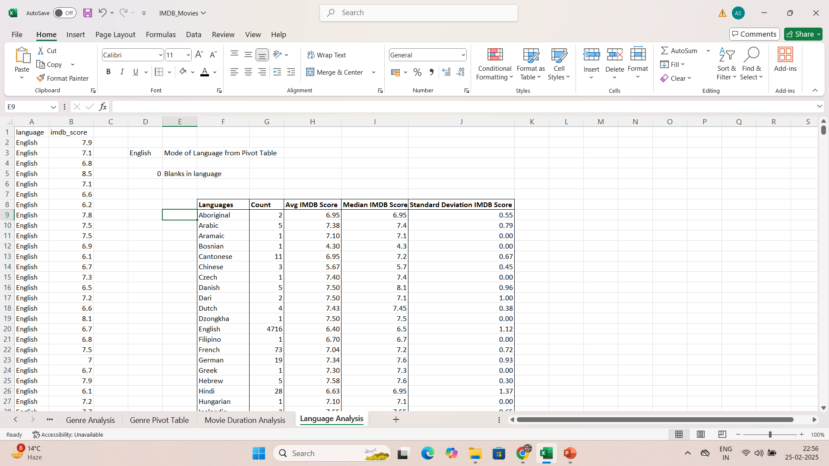
Language Analysis
English is the most famous language among the movie languages.
Movies with low count have higher average rating than with high count, with Telugu and Polish language having highest average IMDB score.
Same as mean, median rating is also higher for language with low count.
Deviation is not much with maximum deviation 1.3 score.

Slide 5

Director Analysis
Top 5 directors according to their average IMDB score are John Blanchard, Cary Bell, Mitchell Altieri, Sadyk Sher-Niyaz and Charles Chaplin respectively.
Directors are arranged in descending order of average IMDB scores.
Total 119 directors have average IMDB score than 90th percentile value of the IMDB score i.e. 7.8.

Slide 6
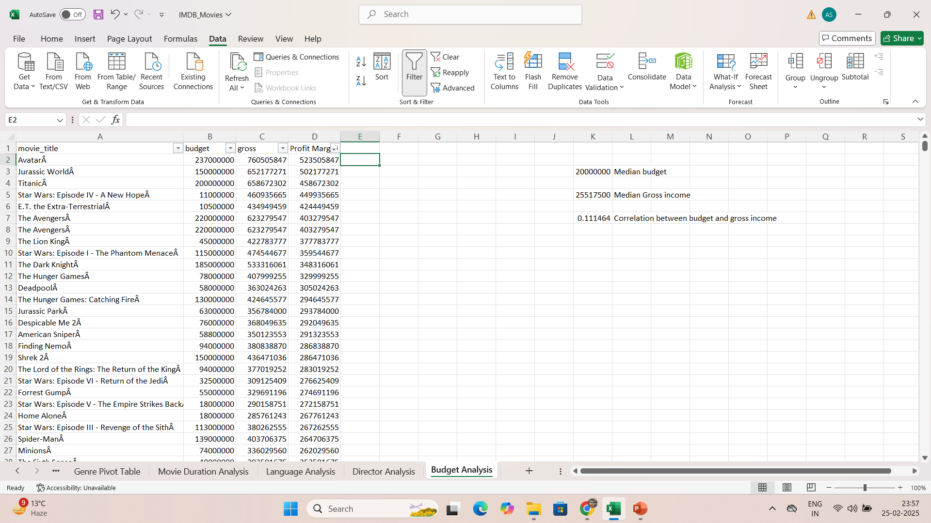
Budget Analysis
Correlation between Budget and Gross Income is 0.11 which is very close to 0, which indicates that relationship between budget and gross income is very weak but as budget increases, gross income will also slightly increase.
According to profit margin in descending order from greatest to lowest, top 5 movies with highest profit margin are Avatar, Jurassic World, Titanic, Star Wars: Episode IV – A New Hope and E.T. – The Extra-Terrestrial respectively.

Slide 7
Excel Sheet Link
https://docs.google.com/spreadsheets/d/1jJ21RBoa9jHRgqFIg0faGBtTCPBJCakC/edit?usp=sharing&ouid=100987342170051497390&rtpof=true&sd=true

Slide 8
THANK YOU
BY-
ALANKAR SAXENA

